Slide 1
CS5242 Tutorial
Week10
GPT (Homework 4)

Slide 2
GPT Generation
We have learned the structure of GPT and its training and inference workflow.
But how does GPT generates tokens from its outputs?
Three different generations methods:
Greedy Search
Beam Search
Sampling

Slide 3

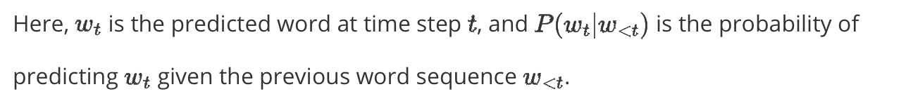
Greedy Search
Greedy search is a simple and straightforward method for text generation.
At each step, it selects the next token with the highest probability according to the language model's output.
This approach is called "greedy" because it greedily chooses the most likely token at each time step without considering future consequences.

Slide 4
Beam Search
Beam search considers multiple candidate words rather than just a single word. At each time step, it keeps track of the top k most likely partial sequences.
Initialization
Initialize a set of beams, each containing the initial sequence and its probability score.
Expansion
For each beam, generate the next token and its prob in the sequence.
Expand each beam by appending each possible next token to the partial sequence.
Selection:
Select the top-k beams with the highest probability scores, where k is the beam width.
Termination:
Repeat until all remaining beams either terminate or reach the max sequence length.

Slide 5
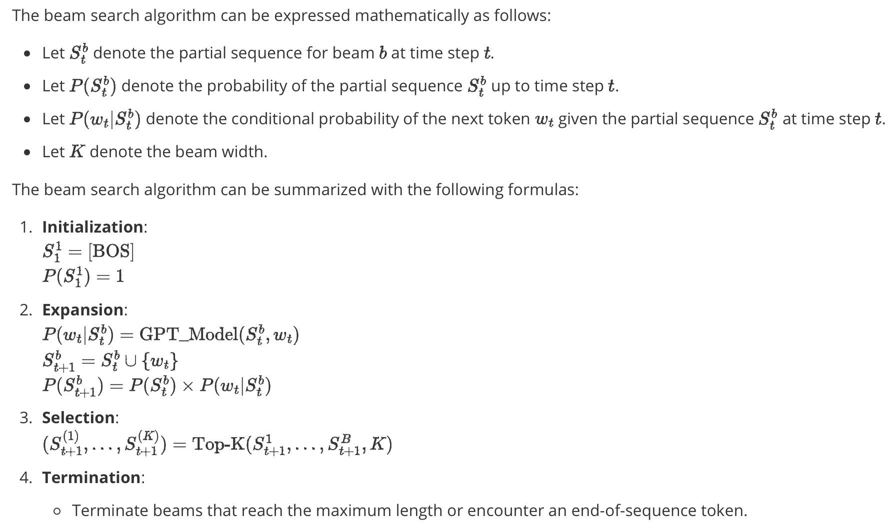
Beam Search

Slide 6

Sampling
Sampling method randomly selects the next word based on the probability distribution of words, instead of always choosing the word with the highest probability.
This formula introduces a top-k constraint to the sampling process, where we first select the top k most likely words according to the distribution, and then randomly sample from these words.

Slide 7
Assignment
Goal: Implement three generation methods
Pretrained model is provided.
Text encoding and decoding is provided.
Task: Complete the generation function.
DDL: 04 April (submit within 10 days)

